Slide 1
Php (hypertext preprocessor)

Slide 2
Introduction to php?
1. History of PHP
Originated in 1994 as PHP/FI.
Major versions:
PHP 1.0 (1995)
PHP 2.0 (1996)
PHP 3.0 (1997)
PHP 4.0 (1999)
PHP 5.0 (2004)
PHP 7.0 (2019)
PHP 8.0 (2020)

Slide 3
What is php?
PHP stands for hypertext preprocessor.
Programming language that is used to built web applications and website.
PHP (Hypertext Preprocessor) is a server-side scripting language, open-source, and widely used for web development.
Can be embedded into HTML or written as standalone scripts.
Also supports GUI apps (via PHP-GTK) and command-line scripting.
Example:
<?php
echo "Hello Students!";
?>

Slide 4
Features of php
Easy for beginners, powerful for professionals.
Free & runs on Windows, Linux, MacOS.
Supports many databases (MySQL, Oracle, SQL Server).
Can generate HTML, PDF, XML, CSV dynamically.
Fast coding & deployment.
Has many frameworks (Laravel, CodeIgniter, Zend).

Slide 5
uses of php
Areas in which php scripts are mainly used.
Server-side scripting → Requires web server + PHP parser (e.g., XAMPP).
Command-line scripting → Run PHP without a browser.
Desktop applications →PHP is for websites. But with PHP-GTK, you can build desktop applications (apps with windows, buttons, menus).
When you create a website (like Facebook or Amazon), the backend code is written in PHP.
PHP code runs on the server, and the result is sent to the browser.
Example:
A file form.php is used to save user data.
User fills a form → PHP runs on the server → Data is saved in the database → Result is shown in the browser.

Slide 6
Scripting language
A scripting language that is interpreted at run
time rather than compiled
Server side scripting language
Client side scripting language

Slide 7
Server side script
Code is execute on server side.
Request
Code execute here
Response
Computer
Server

Slide 8
client side script
Code is execute on client side.
Code execute here
Request
Response
Computer
Server

Slide 9

Basic PHP Syntax
<!DOCTYPE html>
<html>
<head>
<title>Example</title>
</head>
<body>
<?php
echo "Hello Students!";
?>
</body>
</html>

Slide 10
PHP vs JavaScript
PHP | JavaScript
Server-side | Client-side
Executes on server | Executes in browser
Backend language | Frontend language
Multi-threaded | Single-threaded
Builds dynamic web apps | Builds interactive UIs

Slide 11
Enhancements in PHP 8.0
Named arguments → More readable functions.
Attributes → Cleaner metadata.
Constructor promotion → Shorter classes.
Union types → Stronger type safety.
Match → Cleaner than switch.
Null-safe operator → Avoids messy null checks.
Error handling → Stricter & safer.
JIT → Faster performance.

Slide 12
Php Installation
System Requirements for PHP
Web server (Apache)
PHP Interpreter
Database (MySQL)

Slide 13
Install php on windows
Option 1: Install Apache + PHP manually, or use packages like XAMPP/WAMP/LAMP/MAMP.
Option 2: Use a hosting service with Apache + PHP + MySQL.
Option 3: Use online compilers like runphponline.com.

Slide 14
Writing PHP Scripts
A PHP script consists of:
Start & End tags <?php ... ?>
PHP code + HTML
Optional comments

Slide 15
PHP with html
<!DOCTYPE html>
<html>
<body>
<?php echo "Hello, Welcome to PHP"; ?>
</body>
</html>

Slide 16
How to run php code
Database Server
PHP
MYSQL
APACHE SERVER

Slide 17
What is echo?
used to output data to the screen
<?php
echo "Hello";
//same as:
echo("Hello");
?>

Slide 18
Variables in php?
A variable in PHP is a container used to store data such as numbers, strings, arrays, or objects. The value stored in a variable can be changed or updated during the execution of the script.
All variable names start with a dollar sign ($).
Variables can store different data types, like integers, strings, arrays, etc.
PHP is loosely typed, so you don’t need to declare a data type explicitly.
Variable values can change during the script’s execution.

Slide 19
Declaring Variables in php
Syntax
$variable_name = value;
< ? php
$name = "XYZ"; // String
$age = 30; // Integer
$salary = 45000.50; // Float
$isEmployed = true; // Boolean
? >

Slide 20
Displaying Variables with echo
<?php
// Defining Variables
$text = "Hello, World!";
$num1 = 10;
$num2 = 20;
// Using echo to print
// value of variables
echo $text . "\n";
echo $num1 . "+" . $num2 . "=";
echo $num1 + $num2;
?>

Slide 21
Output
Hello, World!
10+20=30
The (.) operator in the above code can be used to concatenate two strings in PHP and the “\n” is used for a new line and is also known as line-break.

Slide 22
Displaying Strings as Multiple Arguments with echo
We can pass multiple string arguments to the echo statement instead of a single string argument, separating them by comma (‘,’) operator. For example, if we have two strings i.e “Hello” and “World” then we can pass them as (“Hello”, “World”).
<?php
echo "Multiple ","argument ","string!";
?>

Slide 23
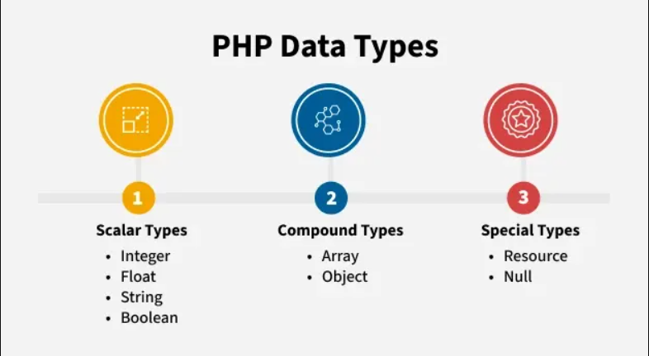
PHP Data Types
In PHP, data types define the kind of value a variable can hold. PHP supports 8 main data types, grouped into three categories:
Scaler Data Types
Compound Data Types
Special Data Types

Slide 24
Operators in php
Operatores are a symbol that tell computer to perform some operation on values and variables
Arithmetic operator
Assignment operator
Logical operator
Ternary operator
Comparision operator

Slide 25
expalin diffferent type of loop statements and their usange?
A loop is used to repeat a block of code multiple times until a condition is met.
While Loop
Repeats code as long as the condition is true.
Condition is checked before execution.
Syntax:
while (condition) {
// code to execute
}

Slide 26
expalin diffferent type of loop statements and their usange?
Example:
$i = 1;
while ($i <= 5) {
echo "Number: $i <br>";
$i++;
}

Slide 27
expalin diffferent type of loop statements and their usange?
Do…While Loop
Similar to while, but it executes the code at least once, even if condition is false.
Condition is checked after execution.
Syntax:
do {
// code to execute
} while (condition);

Slide 28
expalin diffferent type of loop statements and their usange?
Example:
$i = 1;
do {
echo "Number: $i <br>";
$i++;
} while ($i <= 5);

Slide 29
expalin diffferent type of loop statements and their usange?
For Loop
Best when you know exactly how many times to run.
Syntax:
for (init; condition; increment) {
// code
}

Slide 30
expalin diffferent type of loop statements and their usange?
Example:
for ($i = 1; $i <= 5; $i++) {
echo "Number: $i <br>";
}
https://github.com/tubahoorain/notes/blob/main/PHP_Loop_Tasks_With_Output.pdf

Slide 31
arrays in php
An array is a special variable , in whichyou can hold more than one valueat a time.
Array function is used to create an aarayin php.
Types of arrays in php.
Indexed array- Arrays with a numeric index
Associative arrays – Arrays with named keys
Multidimentional arrays – Arrays containing one or more arrays

Slide 32
Types of arrays in php
INDEXED ARRAY
$subject = array(
“English”,
“Math”,
“Economics”
);
Hihkjhkj hjkhjkhjk hjkhjkhjk hjkhjk hjkhjk ASSOCIATIVE ARRAY
$age = array(
“Ali” => 23,
“Bilal” => 32,
“zara” =>33
);
key
value

Slide 33
indexed array
Ex – 1 (Indexed array)
$name = array(“Ali” , “Rehman” , “Usman” , “Bilal”);
Echo count($name);
Ex – 2
$name = array("Ali" , "Rehman" , "Usman" , "Bilal");
$arrlength = count($name); //4
for($x = 0; $x < $arrlength; $x++){
echo "Indexed number [$x] " .$name[$x];
echo "<br>";
}

Slide 34
indexed array
Ex - 3
$a =array (1,2,3,4,5,6,7,8,9);
$a[9]=“Ali";
echo "<pre>";
print_r($a)."<br>";
The print_r() function prints the information about a variable in a more human-readable way.

Slide 35
Associative array
Ex - 4
$name = array(1=>“Usman", 2=>"komal", 3=>"nosheen", 4=>"ayesha", 5=>"neha", 6=>"hafsa" );
$a[5]="urooj";
$a[9]="alia";
$a[10]="ali";
$a[11]="azam";
$a[12]="hamza";
echo "<pre>";
print_r($a);
echo "</pre>";

Slide 36
Associative array
Ex -5 (associative array)
$marks=[“Phy"=>90,“Math"=>90,“Economics"=>70];
Echo $marks[“phy”]; //90
echo “Ali has got “ .$marks[‘phy’] .”marks.”;

Slide 37
for each loop syntax in php
forech($array as $value){
//statement
}

Slide 38
for each loop for indexed array in php
$test = array(10,20,30,40);
forech($test as $value){
echo $value .”<br>”;
}

Slide 39
for each loop for associative array in php
$age = [
“Ali” => 23,
“Bilal” => 32,
“zara” =>33
];
forech($age as $key => $value){
echo $key .”=“ .$value .”<br>”;
}

Slide 40
Multi-dimentional array
Ex - 6
$a = array(
array(1,2,3,4,5),
array(6,7,8,9,10),
array(11,12,13,14),
array(15,16,17,18,19,20)
);
echo $a[0][1]."<br>";
echo $a[3][3]."<br>";
echo $a[2][2];
echo"<pre>";
print_r($a);
echo"</pre>";
echo "<br>";

Slide 41
Multi-dimentional array
Ex - 7
$data=[
[1,"Tuba","Engineer",40000],
[2,"Ali","Manager",50000],
[3,"Maha","Doctor",70000]
];
echo "<pre>";
print_r($data);
echo "<br>";

Slide 42
Multi-dimentional array
Ex - 7
$a = array(
array(1,2,3,4,5),
array(6,7,8,9,10),
array(11,12,13,14),
array(15,16,17,18,19,20)
);
echo $a[0][1]."<br>";
echo $a[3][3]."<br>";
echo $a[2][2];

Slide 43
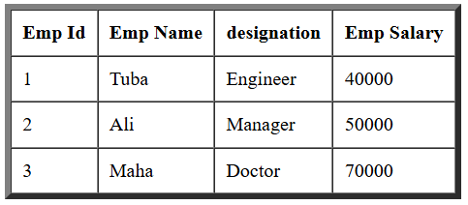
Multi-dimentional array
Ex - 8
$data=[
[1,"Tuba","Engineer",40000],
[2,"Ali","Manager",50000],
[3,"Maha","Doctor",70000]
];
echo "<table border='5px' cellpadding='9px' cellspacing='0'>";
echo "<tr>
<th>Emp Id</th>
<th>Emp Name</th>
<th>designation</th>
<th>Emp Salary</th>
</tr>";
foreach($data as $value){
echo "<tr>";
foreach($value as $alldata){
echo "<td> $alldata </td>";
}
echo "</tr>";
}
echo "</table>";
00
01
02
03
10
11
12
13
20
21
22
23

Slide 44
PHP Array Sorting Functions
Function | Description
sort() | Sort indexed arrays in ascending order
rsort() | Sort indexed arrays in descending order
asort() | Sort associative arrays in ascending order, by value
ksort() | Sort associative arrays in ascending order, by key
arsort() | Sort associative arrays in descending order, by value
krsort() | Sort associative arrays in descending order, by key

Slide 45
PHP Array Sorting Functions
sort() – Ascending Sort (Indexed Array):
$fruits = ["Banana", "Apple", "Mango"];
sort($fruits);
print_r($fruits);
Output:
Array ( [0] => Apple [1] => Banana [2] => Mango )

Slide 46
PHP Array Sorting Functions
rsort() – Descending Sort (Indexed Array)
$numbers = [3, 1, 5, 2];
rsort($numbers);
print_r($numbers);
Output:
Array ( [0] => 5 [1] => 3 [2] => 2 [3] => 1 )

Slide 47
PHP Array Sorting Functions
asort() – Ascending by Value (Associative Array)
$ages = ["John" => 25, "Ali" => 30, "Bilal" => 22];
asort($ages);
print_r($ages);
Output:
Array ( [Bilal] => 22 [John] => 25 [Ali] => 30 )

Slide 48
PHP Array Sorting Functions
ksort() – Ascending by Key (Associative Array)
$ages = ["John" => 25, "Ali" => 30, "Bilal" => 22];
ksort($ages);
print_r($ages);
Output:
Array ( [Ali] => 30 [Bilal] => 22 [John] => 25 )

Slide 49
PHP Array Sorting Functions
arsort() – Descending by Value (Associative Array)
$ages = ["John" => 25, "Ali" => 30, "Bilal" => 22];
arsort($ages);
print_r($ages);
Output:
Array ( [Ali] => 30 [John] => 25 [Bilal] => 22 )

Slide 50
PHP Array Sorting Functions
krsort() – Descending by Key (Associative Array)
$ages = ["John" => 25, "Alice" => 30, "Bob" => 22];
krsort($ages);
print_r($ages);
Output:
Array ( [John] => 25 [Bob] => 22 [Alice] => 30 )

Slide 51
functions in php
A fuction is a block of code that perform a specific task.
you can write the code once and use it many times by calling the function
Syntax
Function function_name{
//statements
}

Slide 52
Create a function
function myMessage() {
echo "Hello world!";
}
myMessage();

Slide 53
Create a function
function introduceMe() { echo "Hi”;
echo "I am Tuba";
echo "I am a web developer <br><br>";
}
introduceMe();

Slide 54
function with return value
<?php
function sum($eng,$urdu,$math){
$sum = $eng + $urdu + $math;
return $sum;
}
echo $total = sum(34, 78, 90);
?>

Slide 55
function with parameter
<?php
function greet($name) {
echo "Hello, " . $name . "!<br>";
}
greet("Zara"); // Output: Hello, Zara!
?>

Slide 56
PHP Form Handling
Form handling is the process of collecting and processing information that users submit through HTML forms. In PHP, we use special tools called $_POST and $_GET to gather the data from the form. Which tool to use depends on how the form sends the data—either through the POST method (more secure, hidden in the background) or the GET method (data is visible in the URL

Slide 57
How html interact with php
Execute php code
Web Browser
HTTP Request
PHP
HTTP Response
Web Server

Slide 58
PHP Form Handling
Types of request
Get Request
Post Request

Slide 59
PHP Form Handling
Get Request
Request is visible in the address bar
Less secure request
Mostly used to get data from the server
Post Request
Request is not visible in the address bar
Secure
Used for create and update operations on server

Slide 60
Send data with GET Request
Make HTML file
Make PHP file
Make input field in HTML file
Receive data in PHP file

Slide 61
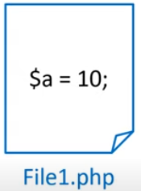

PHP : super global variable
Super global variable

Slide 62
PHP : super global variable
$_GET
$_POST
$_REQUEST
$GLOBALS
$_SERVER
$_SESSION
$_COOKIE
$_FILES

Slide 63
php : $_get & $_post
$_POST : It is a super global variable used to collect data from the HTML form after submitting it.

Slide 64
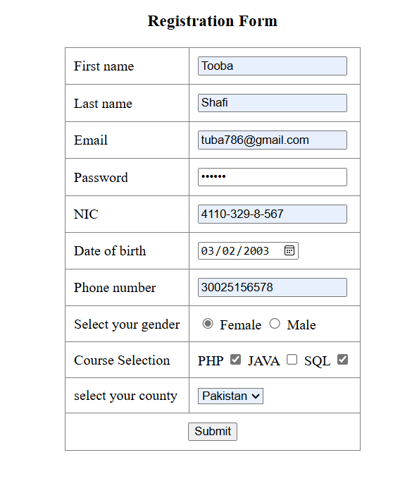
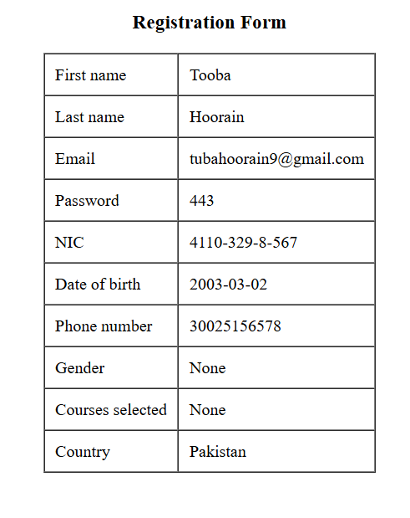
php : $_get & $_post
File1.php
File2.php
Database
print

Slide 65
form using get and post method
name: The name attribute is crucial in PHP form handling, as it is used to refer to the data submitted by the form fields.
$username = $_POST['username']; // Accessing the form data

Slide 66
form using get and post method
Ex-1:
Login.html
<form method="get" action="login.php">
<input type="text" name="user_name" placeholder="Enter user name">
<br><br>
<input type="password" name="user_password" placeholder="Enter user password">
<br><br>
<button type="submit">Login</button>
</form>

Slide 67
form using get and post method
Login.php
<?php
echo "This is php login file"
?>
https://github.com/tubahoorain/Connect-Html-Form-with-Mysql-database-using-PHP

Slide 68
Php : $_server
HTTP connection
Server Information
Host Information
URL Information
2nd page not use

Slide 69
Php : $_REQUEST
$_REQUEST is a superglobal array in PHP.
It is used to collect data sent from an HTML form or through the URL.
It can contain values from:
$_GET → data sent in URL query string
$_POST → data sent via POST method

Slide 70
Php : $_cookie
A cookie is a small piece of information which is stored at client browser.it is used to recognize the user.
Cookie is created at server side and saved to client browser
Cookies in PHP are created using the setcookie() function. When a cookie is set, the data is stored in the user’s browser and sent to the server with each subsequent request made by the browser.
<?php
setcookie('username', 'Tuba', time()+3600);
?>

Slide 71
Php : $_cookie
Syntax:
setcookie(name, value, expire, path, domain, security,httponly);
Name: It is used to set the name of the cookie.
Value: It is used to set the value of the cookie.
Expire: It is used to set the expiry timestamp of the cookie, after which the cookie can't be accessed.
Path: It is used to specify the path on the server for which the cookie will be available.
Domain: It is used to specify the domain for which the cookie is available.
Security: It is used to indicate that the cookie should be sent only if a secure HTTPS connection exists.

Slide 72
Cookie VS Sessions
Cookies | Sessions
Stores users information on the Web browser even after the user exits the Web browser | Stores user information on the Web server and destroys it once the user exits the Web browser
Allows users to disable cookies | Does not allow users to disable session
Has size limits | Does not have size limits
Cookies example

Slide 73
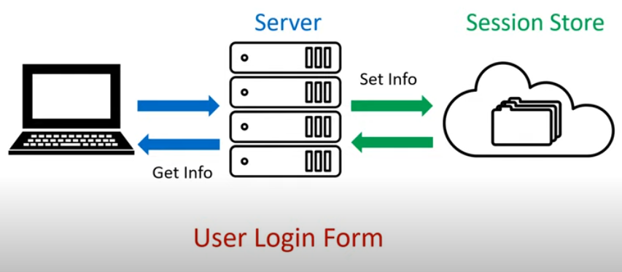
Php : $_session

Slide 74
Php : $_server
A PHP session stores user data on the server and uses a unique session ID to keep track of the user across multiple pages.

Slide 75
Three step to get and set session value
Using PHP sessions involves several key steps: starting a session, storing data in session variables, retrieving data, and eventually destroying the session when no longer needed.
Step 1: Starting a Session (session_start(); // Start the session)
Step 2: $_SESSION[‘name'] = ‘value'; //set session name and value
Step 3 : echo $_SESSION[‘name'];
Delete session:
Step 1: session_unset(); //remove all session variable
Step : session_destroy();

Slide 76
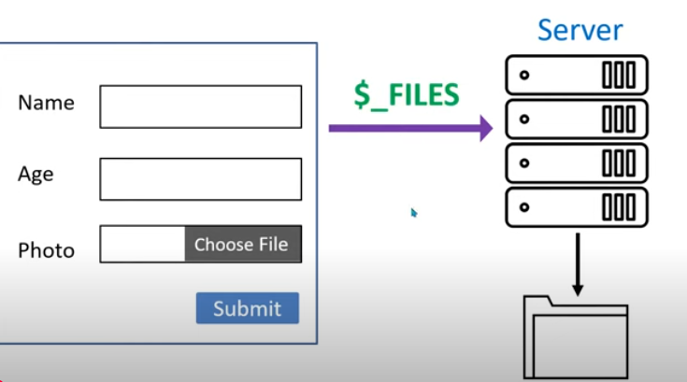
Php : $_file
Folder on server

Slide 77
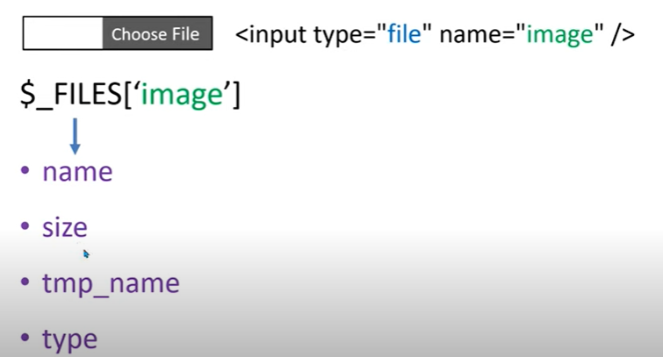
Php : $_file
(JPG/PNG/GIF)
Move_uploaded_file(file,dest)
//upload img on server
Once we get information then we will use this function

Slide 78
Move_uploaded_file :
Used to upload client side image on server

Slide 79
Php die and exit function
Move_uploaded_file :
Used to upload client side image on server

Slide 80
Connecting PHP with MySQL Database
Make variables for connection
Make connect with mysqli class
Get the table list from database

Slide 81
Connecting PHP with MySQL Database
Ex:
<?php
$host = "localhost";
$user = "root";
$pass = " ";
$db = "demo";
$con = mysqli_connect($host,$user,$pass,$db);
if($con){
echo "OK";
}
else
{
echo "DB not Connect";
}
?>

Slide 82
Connecting PHP with MySQL Database (connect.php)
<?php
$hostname = 'localhost';
$username = 'root';
$password = '';
$database = 'signupform';
$con = mysqli_connect($hostname, $username, $password, $database);
if (!$con) {
die("Connection failed: " . mysqli_connect_error());
}
?>

Slide 83
Connecting PHP with MySQL Database (signup.php/html form)
<?php if ($_SERVER['REQUEST_METHOD'] == 'POST') {
include 'connect.php'; $username = $_POST['username'];
$password = $_POST['password']; $sql = "INSERT INTO registration (username, password) VALUES ('$username', '$password')";
$result = mysqli_query($con, $sql); }
?>

Slide 84
Form validation in PHP
Form validation in PHP is the process of checking
user input in an HTML form before the data is sent to the server.
This helps ensure that the submitted data is complete
and in the correct format.

Slide 85
PHP Functions
PHP Built-in Functions
Functions already provided by PHP.
1. abs() : Returns the absolute (positive) value of a number.
Example:
echo abs(-5.4); // Output: 5.4 (absolute value)

Slide 86
PHP Functions
2. gettype() : Tells the data type of a variable.
Example:
$x = 10;
echo gettype($x);
3. var_dump() : Shows detailed information about a variable (data type + value).
Example:
$y = "Hello";
var_dump($y);

Slide 87
PHP Functions
2. PHP Array Functions
Functions to work with arrays.
Example:
$names = array("Ali","Sara","Ahmed");
echo count($names); // Output: 3

Slide 88
What isphp crud:
database
create
read
update
delete

Slide 89
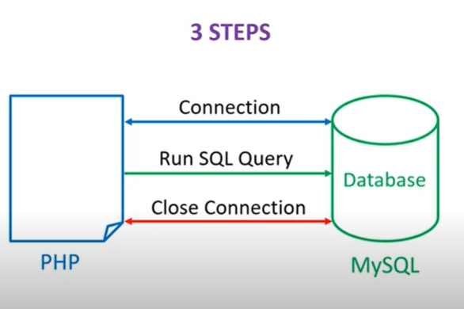
Php and mysql programming steps

Slide 90
Connection
mysqli_connect(server name, user name, password, database name);
Ex:
$con = mysqli_connect($hostname, $username, $password, $database);
Run SQL Query
mysqli_query(connection name , sql query)
Close connection
Mysqli_close(connection name)

Slide 91
process to set up a local server for sending an email
1. Install & Start XAMPP
Download and install XAMPP.
From the XAMPP control panel, start Apache (and MySQL if needed).
2. Configure php.ini for Mail
Locate php.ini in xampp\php\php.ini, then open it.
Find the [mail function] section and add/uncomment:
SMTP = smtp.gmail.com
smtp_port = 587
sendmail_from = your-email@gmail.com
sendmail_path = "C:\xampp\sendmail\sendmail.exe -t"

Slide 92
process to set up a local server for sending an email
Sendmail.ini
smtp_server = smtp.gmail.com
smtp_port = 587
smtp_ssl = auto
auth_username = tubahoorain9@gmail.com
auth_password = your Gmail App‑Password

